Slide 1
SAM

Slide 2
SAM CAUSES
HCM patients
Dobutamine stress echo
Hypertension /Lvh/ diuretics
MVP repair
Apical MI/ Takotsubo

Slide 3
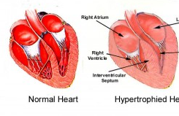

Slide 4
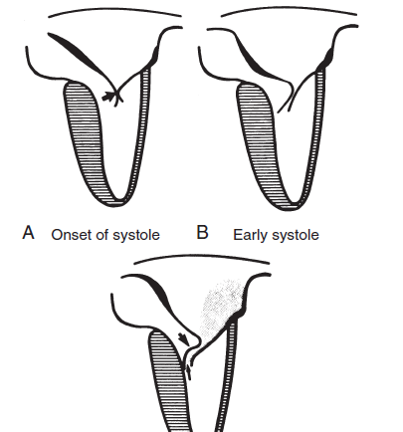

Slide 5
Notes:
Grading 10.. 30 % time

Slide 6
ECHO GRADING OF SAM
Notes:
Distance e-septum and duration of contact

Slide 9
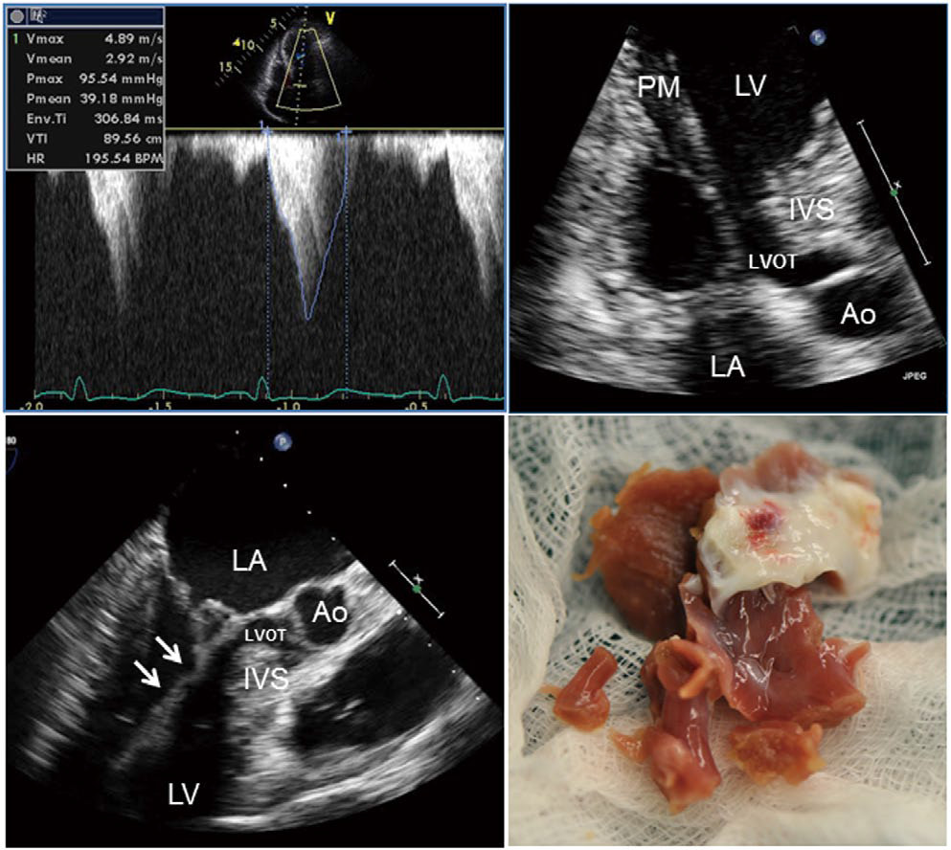

Slide 10
Explanations for the SAM of the mitral valve
Mitral valve is drawn toward the septum because of the lower pressure that occurs as blood is ejected at high velocity through a narrowed outflow tract (Venturi effect)
Mitral valve is pulled against the septum by contraction of the papillary muscles, which occurs because of the valve's abnormal location and septal hypertrophy altering the orientation of the papillary muscles
Hydrodynamic “drag” or the “pushing” force of flow

Slide 11
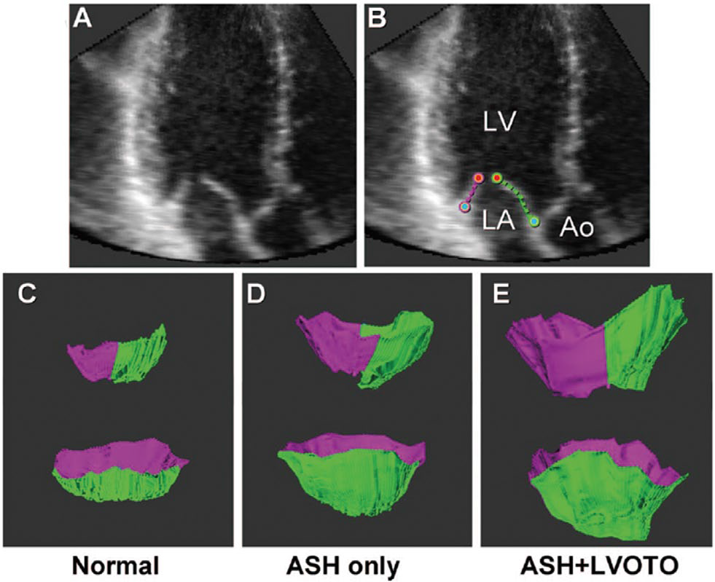

Slide 12
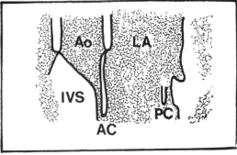
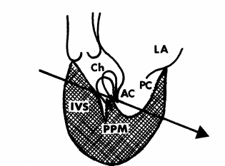
Elongated mitral leaflet causing SAM
Christine Rodger British Heart Journal, 1976, 38, 732-737.

Slide 13
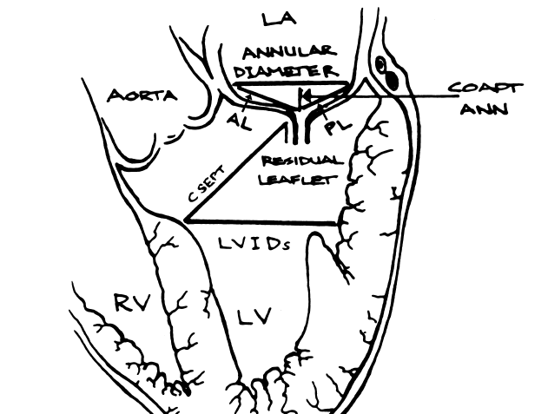

Slide 14
Patterns of systolic anterior motion of the mitral valve in hypertrophic cardiomyopathy: assessment by two-dimensional echocardiography. –maron et al
In 36 patients (58%), both the anterior and posterior mitral leaflets appeared to participate in SAM.
In 19 patients (31%), SAM was produced selectively by the posterior mitral leaflet.
In only 6 patients (10%) was the anterior leaflet alone responsible for SAM.
In 51 patients (82%), only the distal portion of the anterior or posterior mitral leaflet approached the septum in systole.

Slide 15
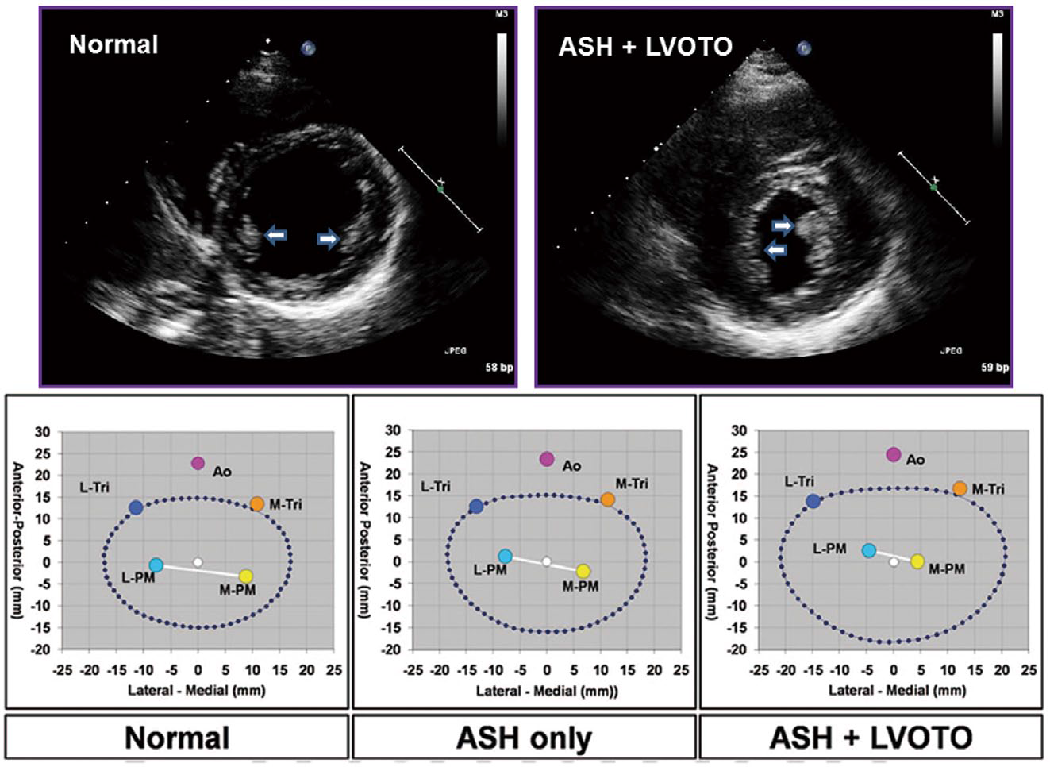

Slide 16
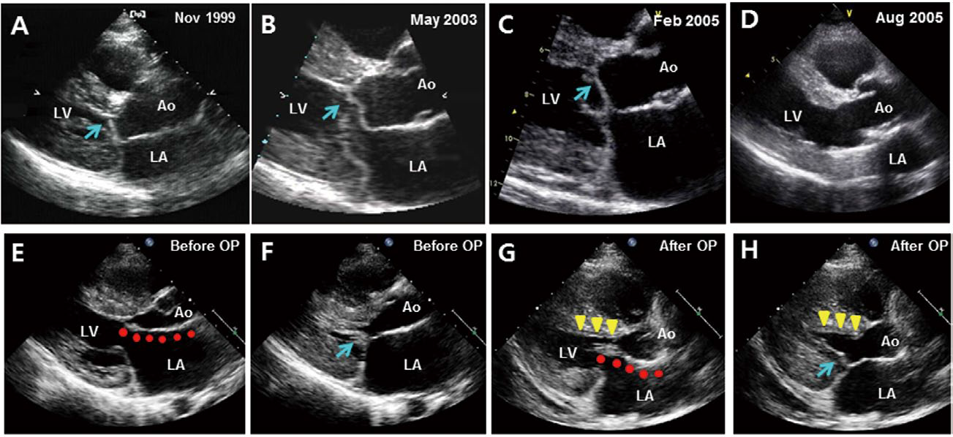

Slide 18
Mitral regurgitation
Mitral regurgitation occurs in almost all patients with obstructive HCM as a consequence of SAM and abnormal mitral leaflet coaptation
Shah PM, Gramiak R, Kramer DH. Ultrasound localization of left ventricular outflow obstruction in hypertrophic obstructive cardiomyopathy. Circulation. 1969

Slide 19
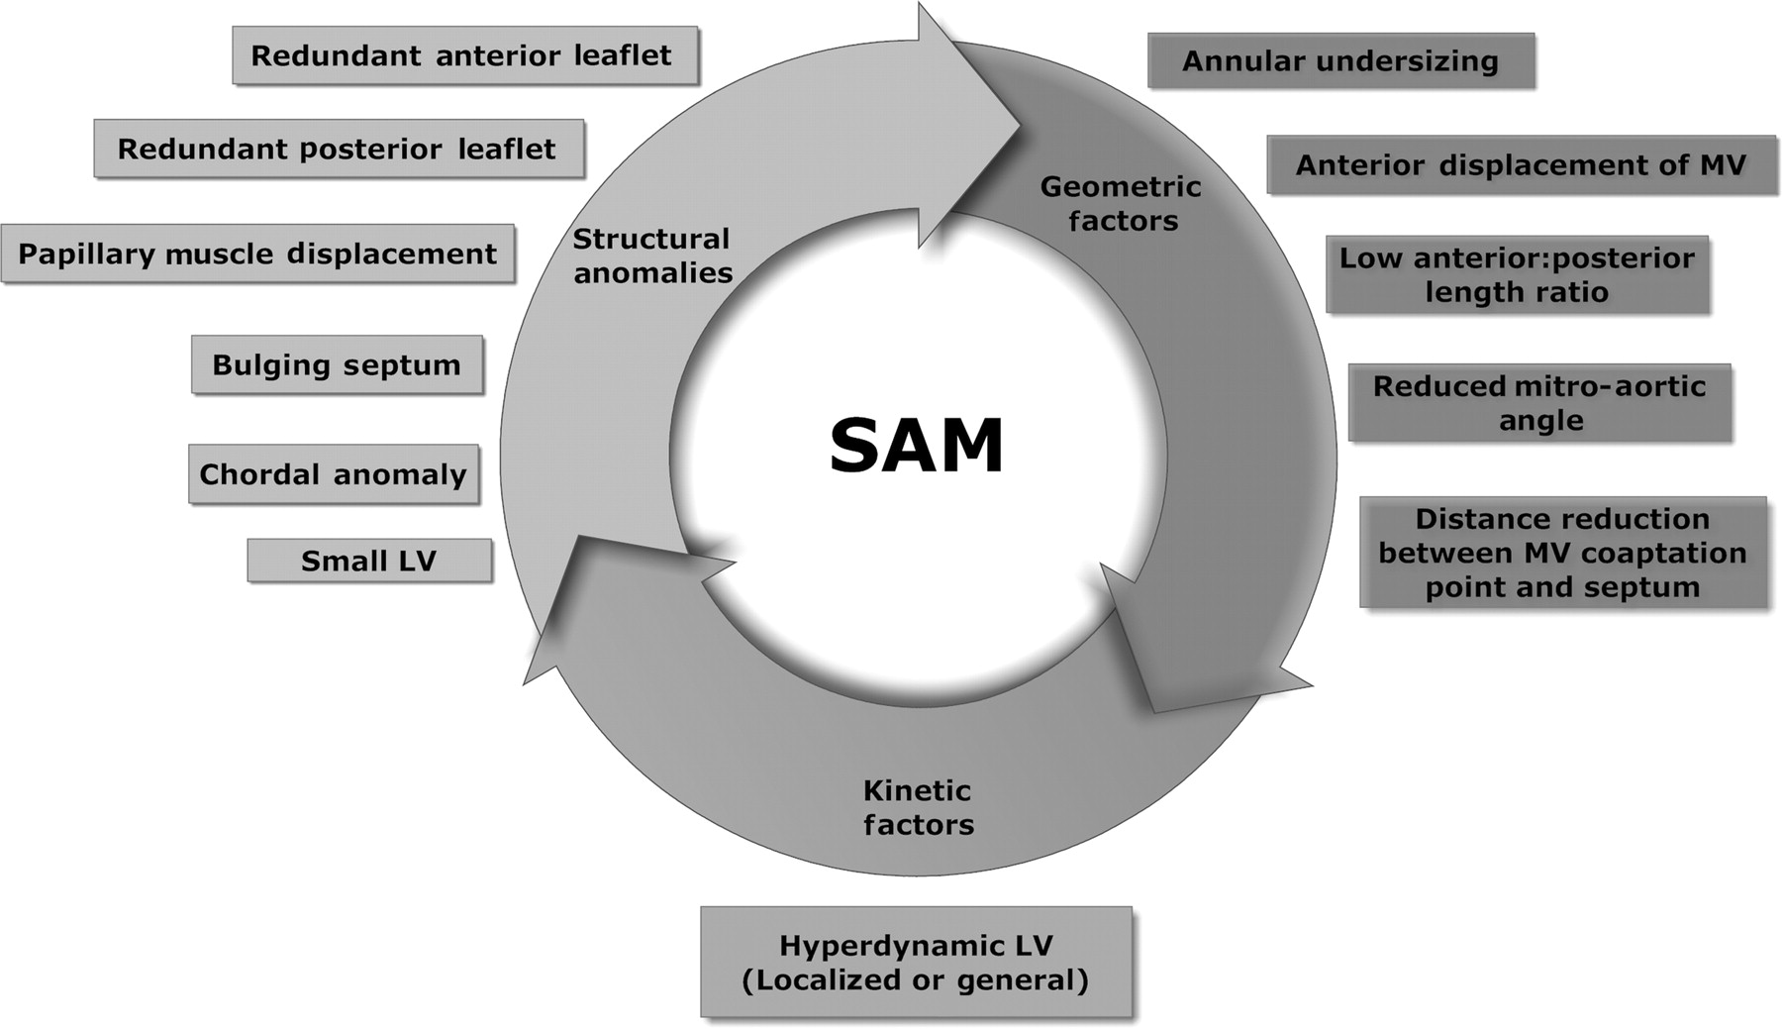
Summary
Michael Ibrahim et al. Eur J Cardiothorac Surg 2012;ejcts.ezr232
© The Author 2012. Published by Oxford University Press on behalf of the European Association for Cardio-Thoracic Surgery. All rights reserved
Notes:
Factors predisposing to SAM. LV: left ventricle; MV: mitral valve.

